Slide 1

Prospectus
Those who are wise will shine like the brightness of heavens
Daniel 12:3
Flourish and Shine in all that we do
New Road, Terling
Essex CM32PN
admin@terling.essex.sch.uk
www.terling.essex.sch.uk

Slide 2
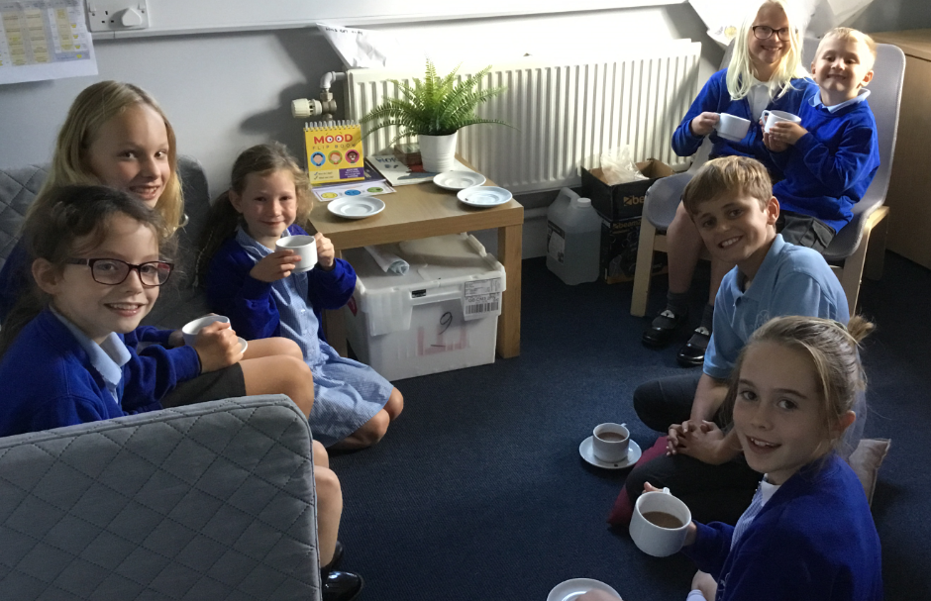
Welcome
We are ambitious about what we want our pupils to achieve, and strive to provide the very highest standards of education. Our staff are highly committed, hardworking and motivated. Our school is a unique place, set in beautiful surroundings with strong links to the church and local community.
The school was built by the second Lord Rayleigh in 1851, to provide education according to the principles and practices of the Church of England.
The children are central to everything we do as a fully inclusive school. We expect all our children to achieve to their full potential by means of a challenging and exciting curriculum that develops a passion for life-long learning. By choosing Terling you and your child will join our welcoming school family.
Terling’s Christian Values
The gifts of courage, trust, respect and truthfulness are the values of Terling Church of England Primary School.
We chose the value respect because the Bible encourages us to value difference, our school environment and our community.
We trust in God to guide us, we trust each other to do the right thing, to look after each other and care for each other. We trust our friends to support us.
We have the courage to try new experiences, to face challenge and to get things wrong, building our resilience.
We build our beautiful rural setting into our curriculum. Our unique, close-knit community helps us build excellent relationships with individual families and children.
We support and challenge our children – academically, spiritually, socially and emotionally – preparing them for the next stage of their education. We equip them with the confidence and life skills to reach their God-given potential.
Our children flourish and grow with a caring, respectful Christian ethos that includes responsibilities around the school. Our children shine as we celebrate their many successes.
Church of England (Aided) Primary School
Girls and boys 4-11 years
Number of pupils on roll 2022: 105
Published admission number 2023-2024: 17

Slide 3
School Day
Morning: 8.45am to 12.15pm
Afternoon: 1.15pm to 3.15pm
Children are encouraged to come into school from 8.35am when the gate is opened. All classes begin Early Morning Work at that time.
Breaks
Break time – 10.30am to 10.45am
Lunchtime – 12.15pm to 1.15pm
Snacks
Children should bring a water bottle to school. Drinks should be water – no fizzy or sugary drinks. Those in EYFS and KS1 are provided with a free piece of fruit daily. Children in KS2 can bring in a piece of fruit to have at break time. To protect those children with allergies, the school is a ‘nut-free zone’.
Lunch
School dinners cost £2.40 per day for children in KS2 and are free for those in EYFS and KS1. Our delicious school lunches are cooked in the school kitchen.
Our classes
All our children in the Early Years Foundation Stage start school at the beginning of September.
Children are in classes named after local Terling farms:
EYFS/ Year 1 Taylors
Year 1/ Year 2 Sandypits
Year 3/ Year 4 Leylands
Year 5/ Year 6 Fardings
Breakfast Club
Breakfast club is open to all pupils and costs £4.00 per session, which includes a choice of breakfast and fun activities. It is open Wednesday, Thursday and Friday from 7.30am to 8.35am during term time (excluding non-pupil days)

Slide 4
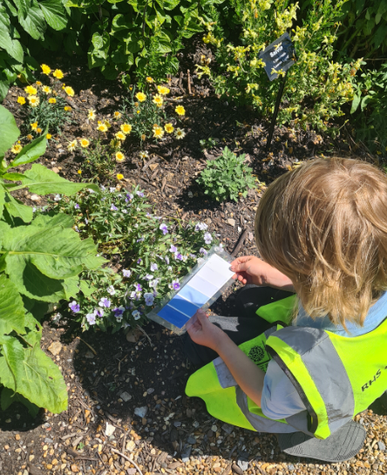
Our Curriculum
Our curriculum uses Chris Quigley’s Essentials Curriculum as its basis, but additionally includes school ‘essentials’ which take the form of additional content to supplement the subjects of the National Curriculum.
We believe it must provide our children with challenges, experiences and opportunities that they may not otherwise experience. It should spike their interest, provoke their curiosity, widen their eyes and enable them to flourish.
We believe that learning should not be contained to the classroom and should include first hand learning experiences which promote skill application, knowledge and excitement for learning.
We allow children to develop interpersonal skills, build resilience, confidence and self-belief, which prepare them for future success and life beyond Terling Primary School.
Forest School
Children in our Early Years Foundation Stage class are provided with a weekly Forest School session. Led by Terry, the children are encouraged to develop their communication skills, team-work, independence and resilience from an early age. This is all within an engaging and fun session which allows children to work on tasks of their choosing, supporting the development of crucial life skills.
Spanish
We believe children of all ages should be taught a modern foreign language. At a young age, children learn an additional language with confidence which provides them with the foundations for future learning. As such, all of our children have a weekly Spanish lesson, starting in the EYFS
Our curriculum is taught through a two-year cycle which is planned to provide, as far as possible, historical sequence.
The curriculum is taught through themes which change half termly or termly. These themes include: Stone Age to Iron Age, Eureka!, I need a hero and Tour of Terling.
We arrange as many opportunities as possible for children to be fully immersed in their learning – we do this through carefully planned school trips and visitors. These have included visits to the British Museum, Hyde Hall and IWM Duxford and visits from a Shakespeare theatre company and Hindu workshops.

Slide 5
Admission
Parents who want their children to attend the school should make an application to Essex County Council in accordance with the co-ordinated admission arrangements. Applications can be made online at www.essex.gov.uk/admissions and must be made by the National Closing Date detailed in the Primary Education in Essex booklet, which is available from the Local Authority. Late applications will be dealt with as detailed in this book.
Parents must also complete a Supplementary Information Form (SIF) which will enable the school to rank applications in accordance with the admissions criteria. The SIF is available from the school and must be returned directly to the school.
The school will admit all children in the September following their fourth birthday, without reference to aptitude or ability. Parents can request that the date their child is admitted to the school is deferred until later in the school year or until the child reaches compulsory school age in that school year. Where entry is deferred the school will hold the place for that child and not offer it to another child. The parent would not however be able to defer entry beyond the beginning of the term after the child’s fifth birthday, nor beyond the academic year for which the original application was accepted.
Where more applications are received than places available within the published number intended to admit, Governors will consider applications according to the following criteria in order of priority:
All Looked After Children* seeking a place at our school
All children residing within the parishes of Terling and Fairstead
Children who have siblings (brothers or sisters/ step siblings, foster siblings and adopted siblings) attending the school who are not in Year 6
Children who have a parent who joins in the worship of the Parish churches of Terling and Fairstead (at least once a month for a year). Supplementary Information Form (SIF) to be completed
All remaining applications – priority decided by straight line distance* from home to school, with the nearest having preference
* See Admission Policy on school website for further details and definitions
A child with an EHC plan that has named Terling in the plan will be admitted to the school, provided the school can successfully meet the statutory needs as set out in the plan.
Unsuccessful applications have a right to appeal to the Statutory Independent Appeals Committee.
The school maintains a waiting list for entry into all classes. This is initially held for one term.

Slide 6
Friends of Terling School (FOTS)
FOTS is an organisation of parents and grandparents who work to encourage closer links between home and school.
As a parent with a child at our school, you are automatically a member of FOTS and we have regular meetings to which you are most welcome to attend. FOTS is best known for its fundraising work through providing excellent social events and opportunities for the school community.
FOTS annual events include a duck race on the River Ter, Easter bunny hunt, raffles, fireworks night and Christmas discos.
FOTS fundraising has provided the school with, amongst other things, books for our Reading Gladiator groups, 15 IPads, class Interactive White Boards, chicken eggs which were hatched and coach travel to Young Voices in the O2.
Helping with transition
We make every effort to ensure the smooth transfer of children to our school. Parents of our new intake are invited to an information evening and three Stay and Play sessions in the summer term.
Prospective parents are most welcome to visit the school by booking onto a planned tour of the school. Dates are advertised on the school website and placed booked via the school office.
Parental Engagement
As part of the Terling family, we feel that parental involvement in school life is vitally important. Parents have regular opportunities to meet with teaching staff through parents evening and those with Special Educational Needs will also attend One Plan meetings.
To help you to support your child’s learning, we also offer training and information sessions linked to your child’s current learning. This allows all adults working with your child to use consistent approaches and improve outcomes.
We hold regular Parent Forum meetings throughout the year, where parents and staff meet together to discuss a range of topics.
We keep all community members informed of what is happening in and around school through our weekly newsletters. These can also be found on the school website.

Slide 7
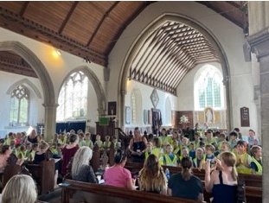
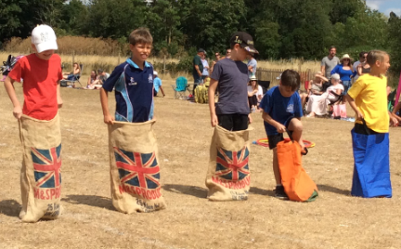
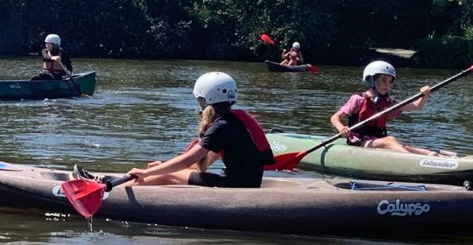
Uniform
School uniform plays a valuable role in contributing to the ethos of our school and setting the appropriate tone. It instils pride, supports positive behaviour and discipline, and encourages identity with, and support for, school ethos.
Physical Education
Physical Education offers opportunities to experience a wide range of activities that can form an important part of our leisure time, promoting a feeling of well-being and enjoyment of life. Physical Education also supports the development of important social skills; healthy lifestyles, determination, co-operation, honesty, loyalty, self-discipline, self respect and respect for others.
Children are taught skills through gymnastics, athletics, dance and games such as football and hockey. In the summer term, children in KS2 have weekly swimming lessons in the village pool.
RE and Collective Worship
As a church school, we have strong links with All Saint’s Church in the village. We have termly services in the church and a representative from the church leads a weekly Collective Worship for us.
Collective Worship is led by different members of the staff team and has a changing focus each week. Worship allows time for reflection and prayer.
Religious Education is taught through weekly lessons, exploring a ‘Big Question’ through three key disciplines – theology, philosophy and human/ social sciences.
Extra Curricular Activities
We offer an extensive programme of out of hours learning which we feel enhances children’s social skills, personal development and self esteem. We are continuously evaluating and reviewing our provision. Current clubs include: Coding, Irock, Reading Gladiators, Languages, Tag Rugby, Super Heroes Fitness, Basketball, Tennis, MiniMe Mindfulness and Multi Sports as well as guitar and piano lessons.

Slide 8
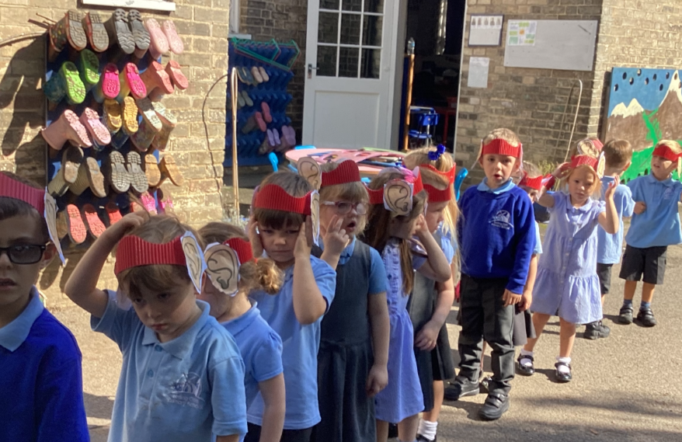
Staff
Headteacher
Mrs Meares
SENCO
Mrs Finch
Teaching staff
Mrs Vincent Miss Ellingham
Mrs Roberts Mrs Partridge
Ms Bacon Miss Chard
Support staff
Mrs Wilby Mrs Filby
Mrs Ward Mrs Eggleton
Mrs Thornhill
Midday Assistant
Mrs Hasler
Finance and Administration
Mrs Wright Miss Davies
Caretaker Catering
Mr Inwood Miss Doe
Mrs Dervish
Mrs Garrod
Cleaning
Mrs Hasler
Governors
Chair of Governors Mrs Santos-Brien
The Governors are responsible for the conduct of the school and for promoting high standards. Governors set the strategic direction of the school, challenge and support by monitoring, reviewing and evaluating.
Should you wish to get in touch with the school governors at any time, they can be contacted via the school office.
We are easily accessed from Witham, Hatfield Peverel, Great Leighs and Boreham, and have children attending from these areas.
For more information please:
See our website: www.terling.essex.sch.uk
Call Mrs Meares: 01245 233206
Make an appointment to come and visit the school by emailing: admin@terling.essex.sch.uk
Over the past few years, we have had children attend Maltings Academy, Rickstones Academy, Notley High School,Plume, King Edward VI Grammar School, Chelmsford County High School for Girls and St John Payne.

Slide 9

What do our parents say about our school?
I can not thank the school enough for giving our son the best introduction to school life. They always go above and beyond.
It is a lovely, small, friendly school where children have friendships that go beyond their year group and throughout the school.
Terling is a wonderful school with a friendly family-like atmosphere
Terling is a wonderful school with amazing staff and teachers
My children feel like they are part of a ‘family’ at the school
The school have worked very hard to make a happy and nurturing place as well as supporting and pushing children in their learning
They value each child as an individual and always go the extra mile to support them
The school is very responsive and supportive

